Slide 1
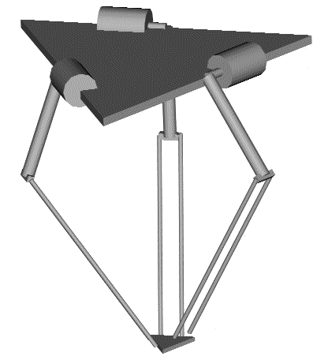
Base
Motors
Control Arms
Joints
Forearms
Traveling Plate
Joints

